Slide 1
Keras and basics of Deep Learning

Slide 2
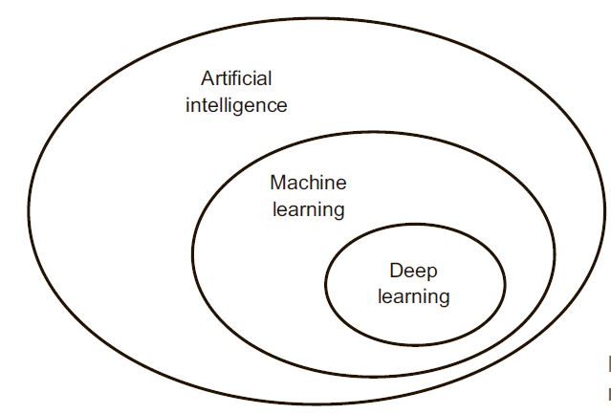
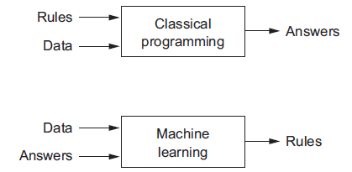
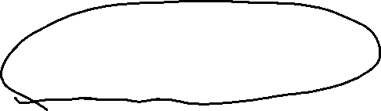

Slide 3
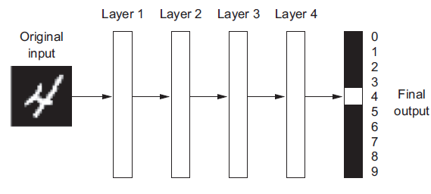
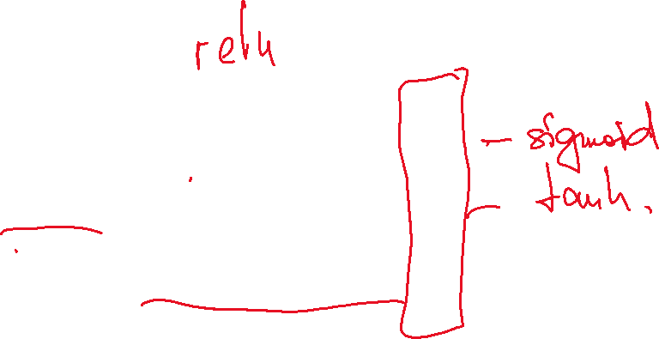

Slide 4
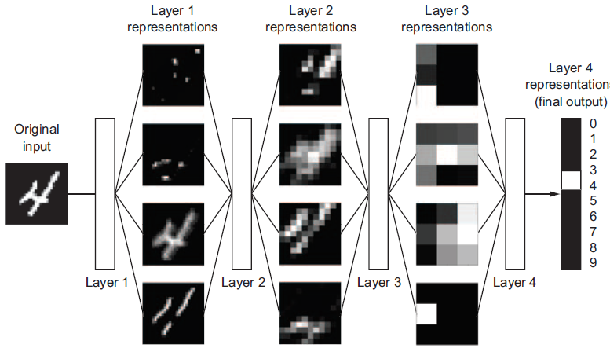

Slide 5
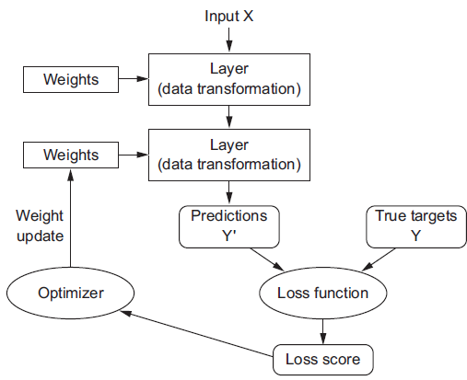
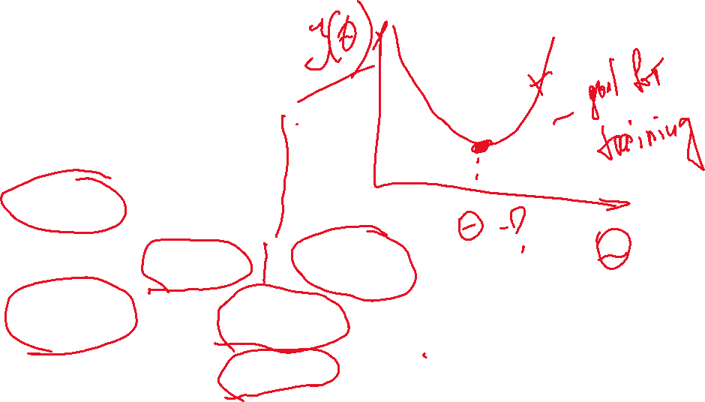

Slide 6
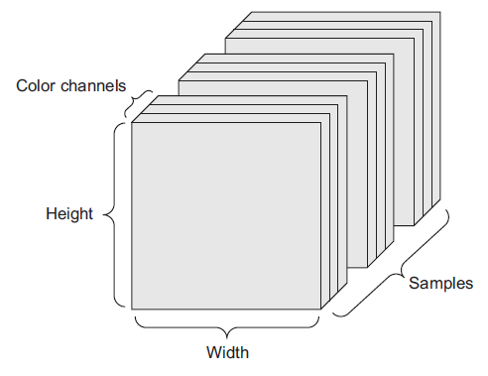

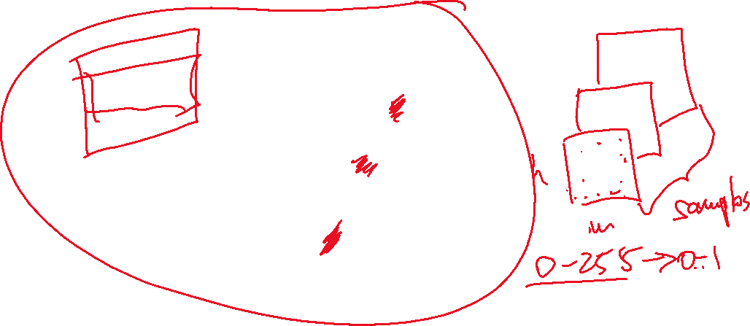

Data representation as tensors
Image Data

Slide 7
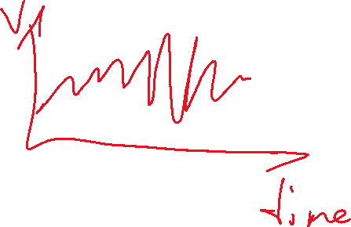



Slide 8
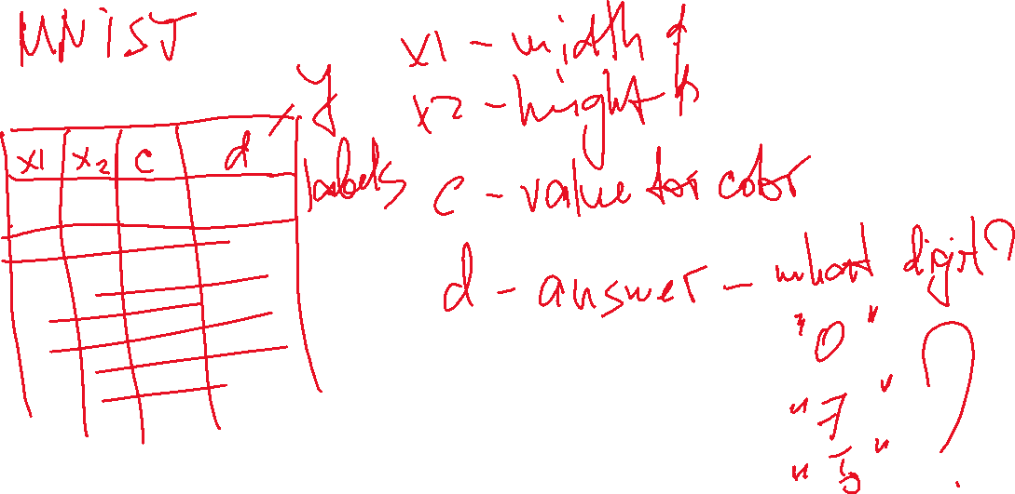

Slide 9
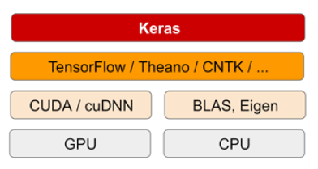
Keras Library

Slide 10
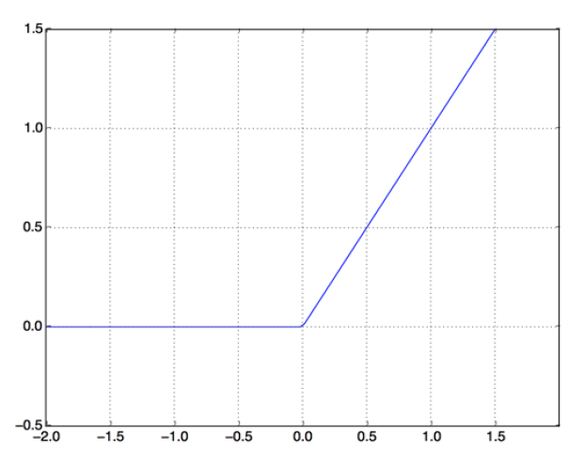
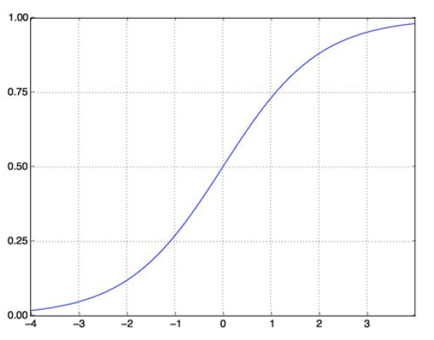



Activation functions
RELU
Sigmoid function

Slide 11
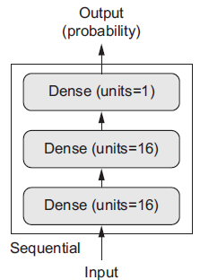
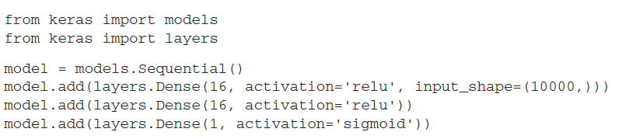




Example. Three-layer network
Example: movie reviews

Slide 12
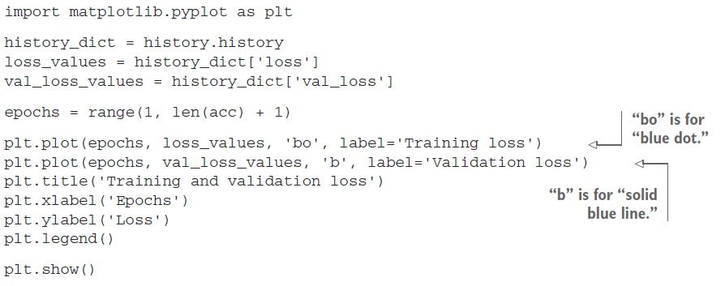
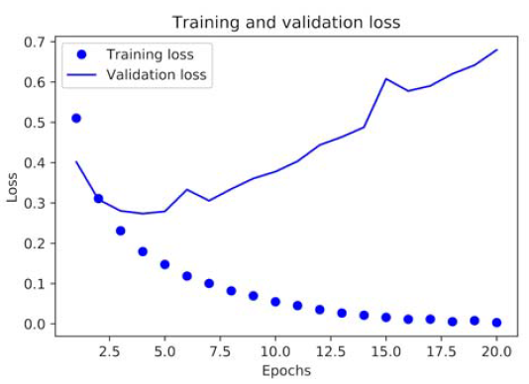
Plotting training and validation loss

Slide 13
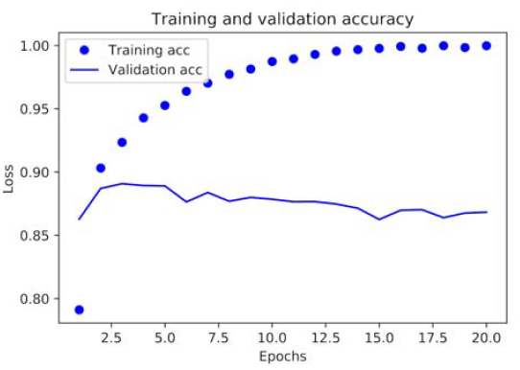
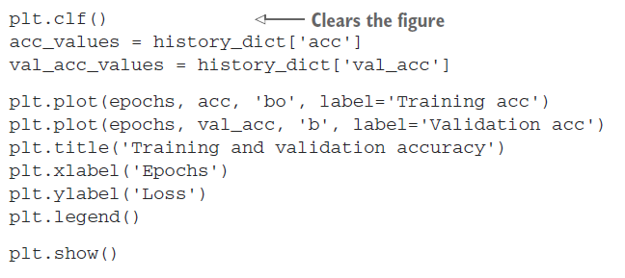
Training and validation accuracy

Slide 14
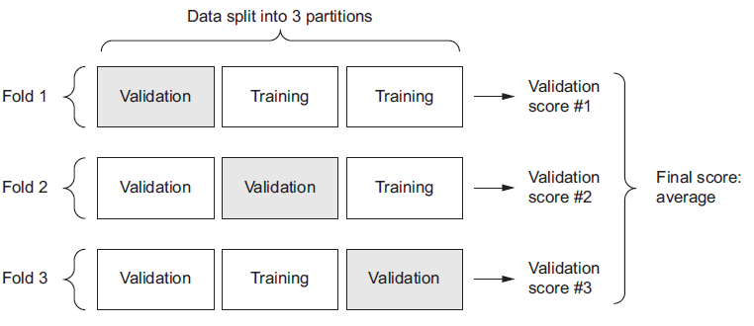
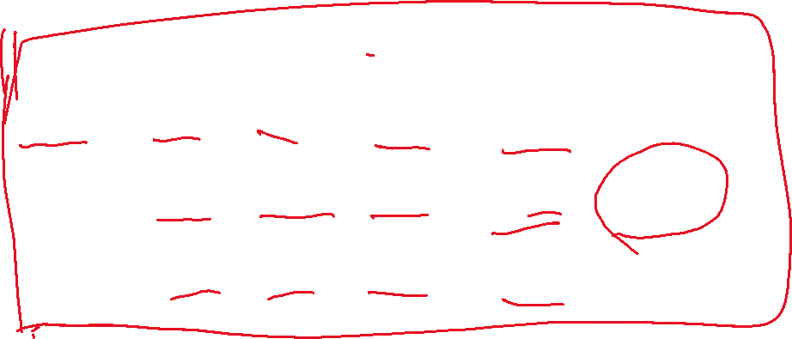
K-fold cross-validation
Example: regression problem

Slide 15
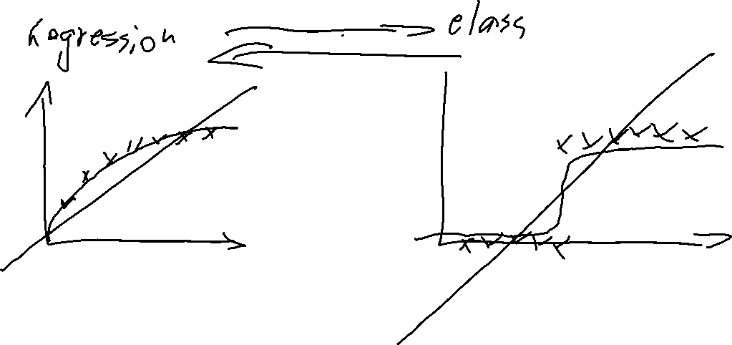

Slide 16
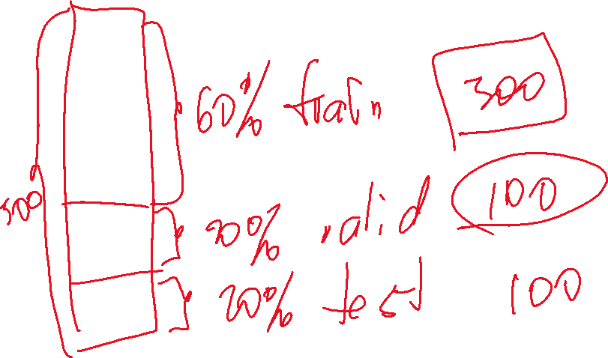
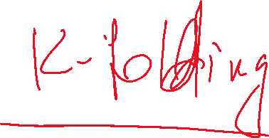

Slide 17
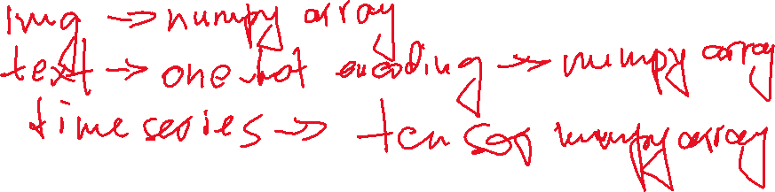

Data preprocessing
Vectorization
Normalization
Handling missing values (skikit Imputer class)
Data augumentation

Slide 18
Data preprocessing. Vectorization
All inputs and targets in a neural network must be tensors of floating-point data (or, in specific cases, tensors of integers). Whatever data you need to process—sound, images, text—you must first turn into tensors, a step called data vectorization.
Example: one-hot-encoding, word2vec

Slide 19

Data preprocessing. Value normalization
You have to normalize each feature independently so that it had a standard deviation of 1 and a mean of 0.
In general, it isn’t safe to feed into a neural network data that takes relatively large values (for example, multidigit integers, which are much larger than the initial values taken by the weights of a network) or data that is heterogeneous (for example, data where one feature is in the range 0–1 and another is in the range 100–200). Doing so can trigger large gradient updates that will prevent the network from converging. To make learning easier for your network, your data should have the following characteristics:
Take small values—Typically, most values should be in the 0–1 range.
Be homogenous—That is, all features should take values in roughly the same range.

Slide 20
Data preprocessing. Missing values
In general, with neural networks, it’s safe to input missing values as 0, with the condition that 0 isn’t already a meaningful value. The network will learn from exposure to the data that the value 0 means missing data and will start ignoring the value.
Note that if you’re expecting missing values in the test data, but the network was trained on data without any missing values, the network won’t have learned to ignore missing values! In this situation, you should artificially generate training samples with missing entries: copy some training samples several times, and drop some of the features that you expect are likely to be missing in the test data.

Slide 21
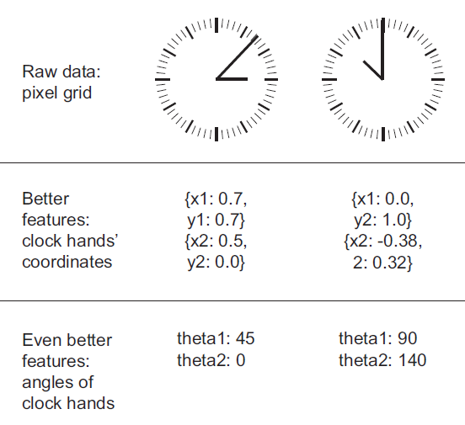
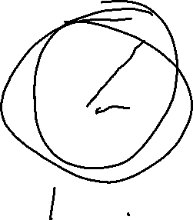
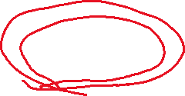
Feature engineering
Feature engineering is the process of using your own knowledge about the data and about the machine-learning algorithm at hand to make the algorithm work better by applying hardcoded (nonlearned) transformations to the data before it goes into the model:
More elegant solution
Far less data

Slide 22
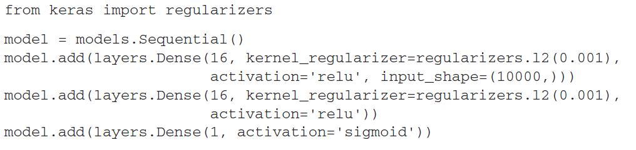
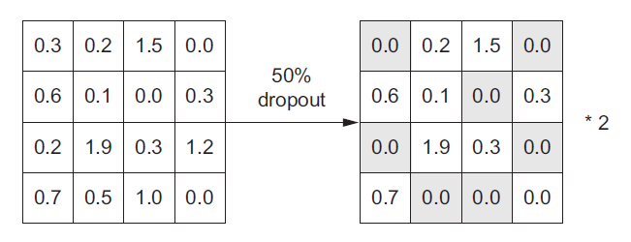

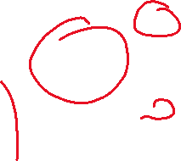


Overfitting avoidance
Take more data
Reduce the network size
Regularization (L1, L2)
Dropout

Slide 23


The universal workflow of machine learning
Defining the problem and assembling a dataset
Choosing a measure of success
Deciding on an evaluation protocol
Maintaining a hold-out validation set
Doing K-fold cross-validation
Doing iterated K-fold validation
Preparing your data
Developing a model that does better than a baseline
Last-layer activation
Loss function
Optimization configuration
Scaling up: developing a model that overfits (add layers, make layers bigger, train more epochs)
Regularizing your model and tuning your hyperparameters
Notes:
1. problem. Is it binary classification? Multiclass classification?
Scalar regression? Vector regression? Multiclass, multilabel classification?
Something else, like clustering, generation, or reinforcement learning? nonstationary problems: clothes seasons; memorize patterns that
are present in your training data.

Slide 24
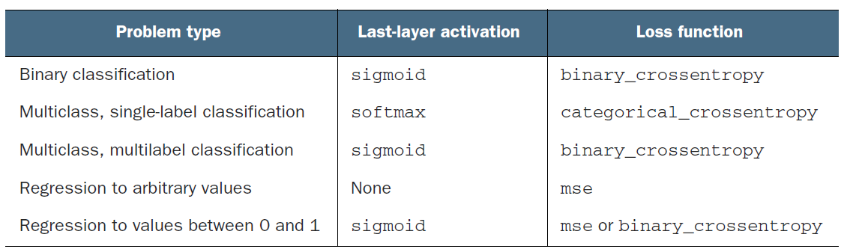

Last-layer activation

Slide 25
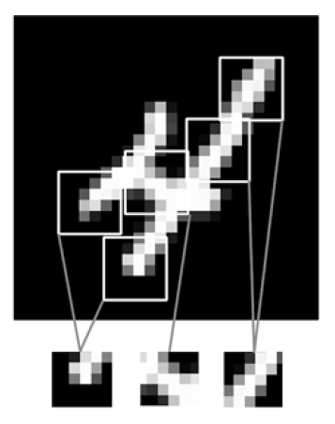
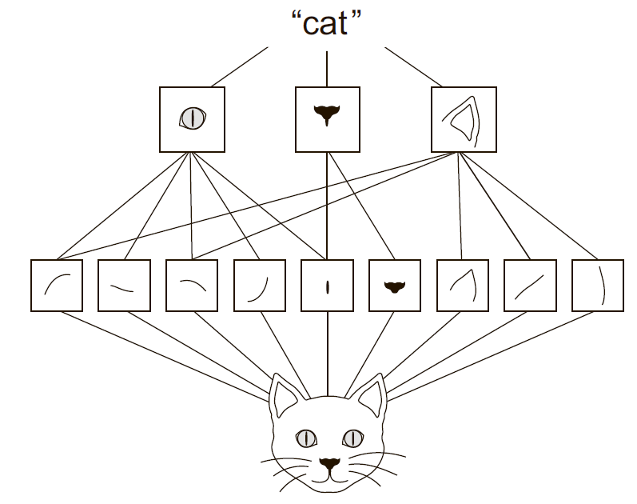
Deep Learning. Convolution
The patterns they learn are translation invariant.
They can learn spatial hierarchies of patterns

Slide 26
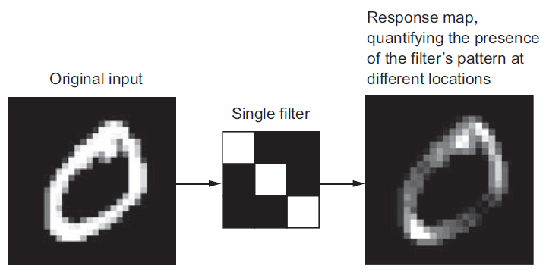
Convolution properties
Size of the patches extracted from the inputs—These are typically 3 × 3 or 5 × 5. In the example, they were 3 × 3, which is a common choice.
Depth of the output feature map—The number of filters computed by the convolution. The example started with a depth of 32 and ended with a depth of 64.

Slide 27
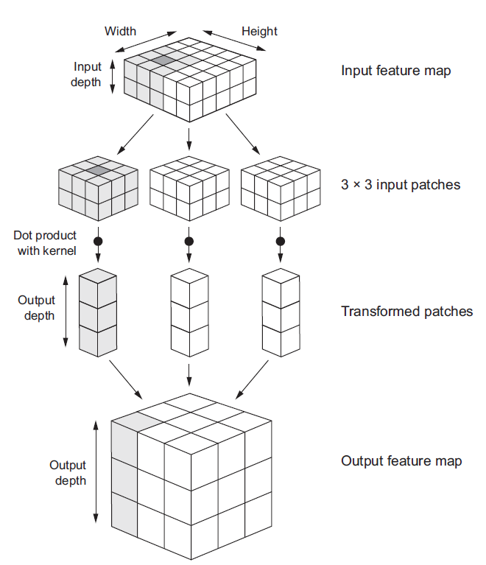
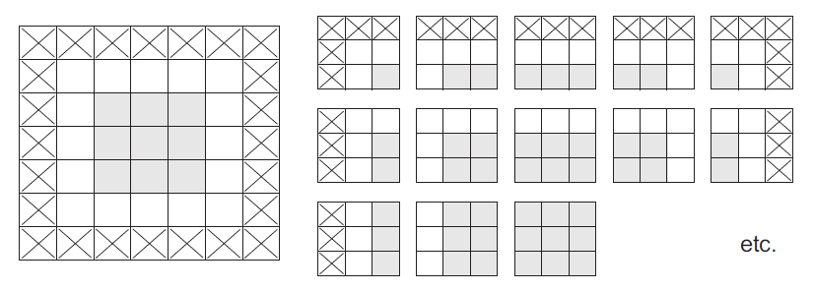
How it works?

Slide 28
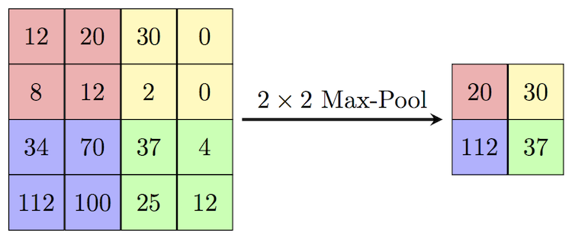
MaxPooling

Slide 29
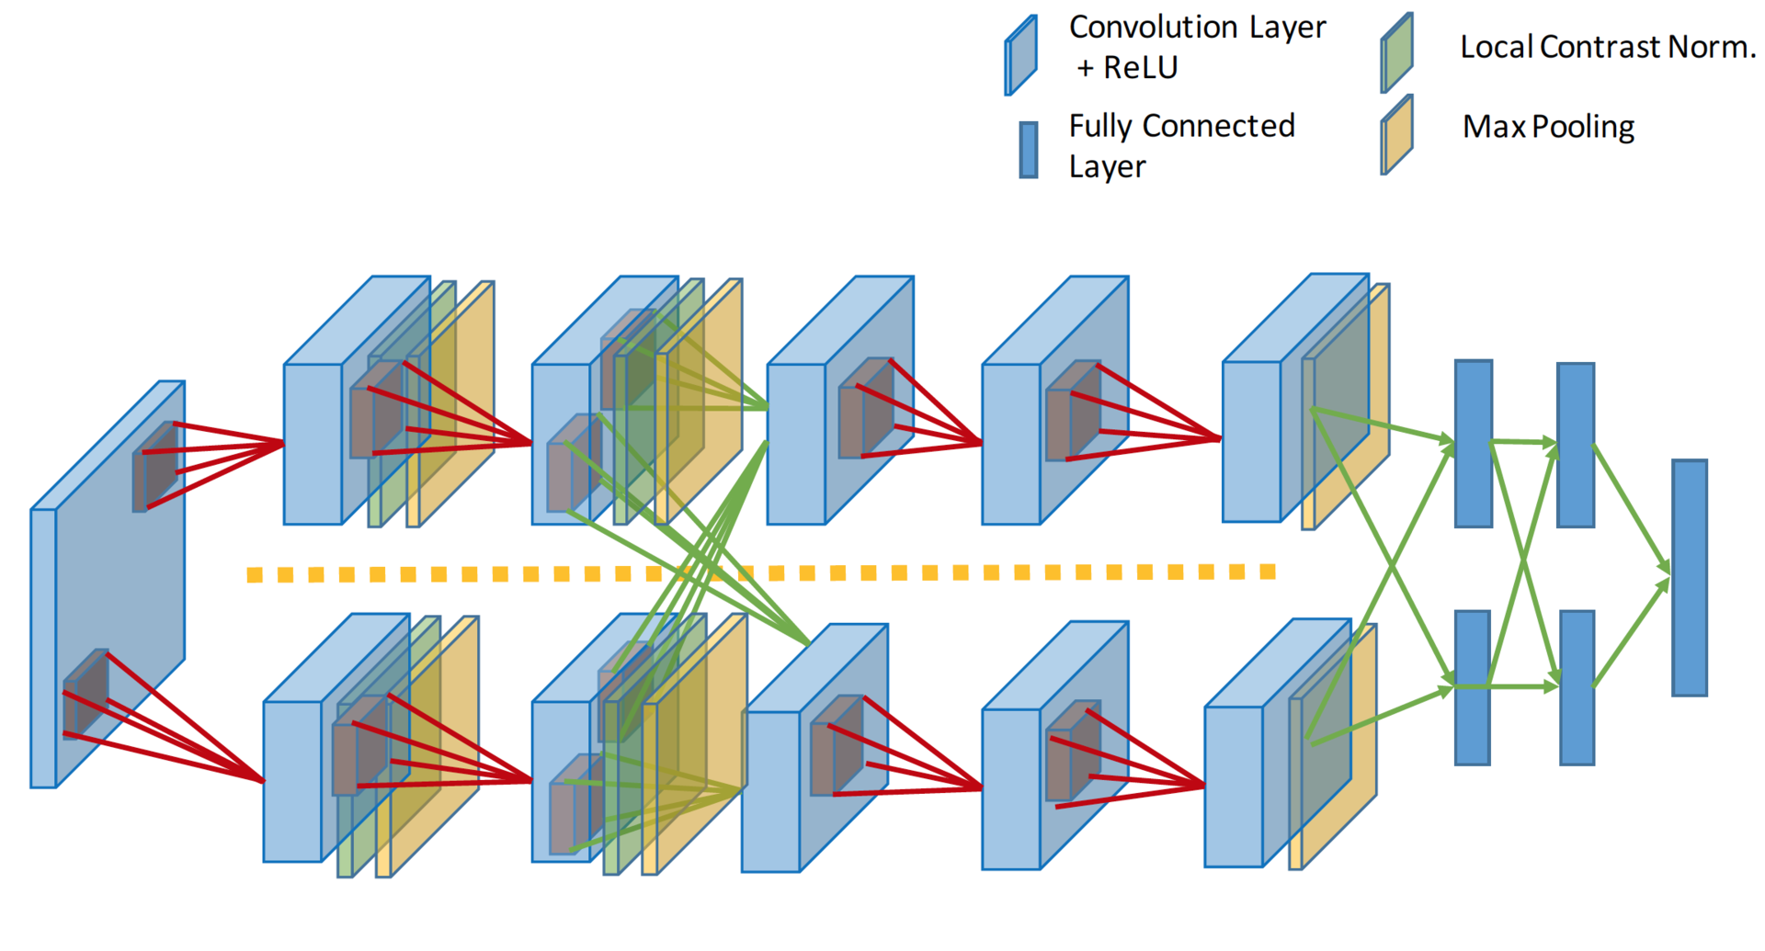
AlexNet (2012)

Slide 30
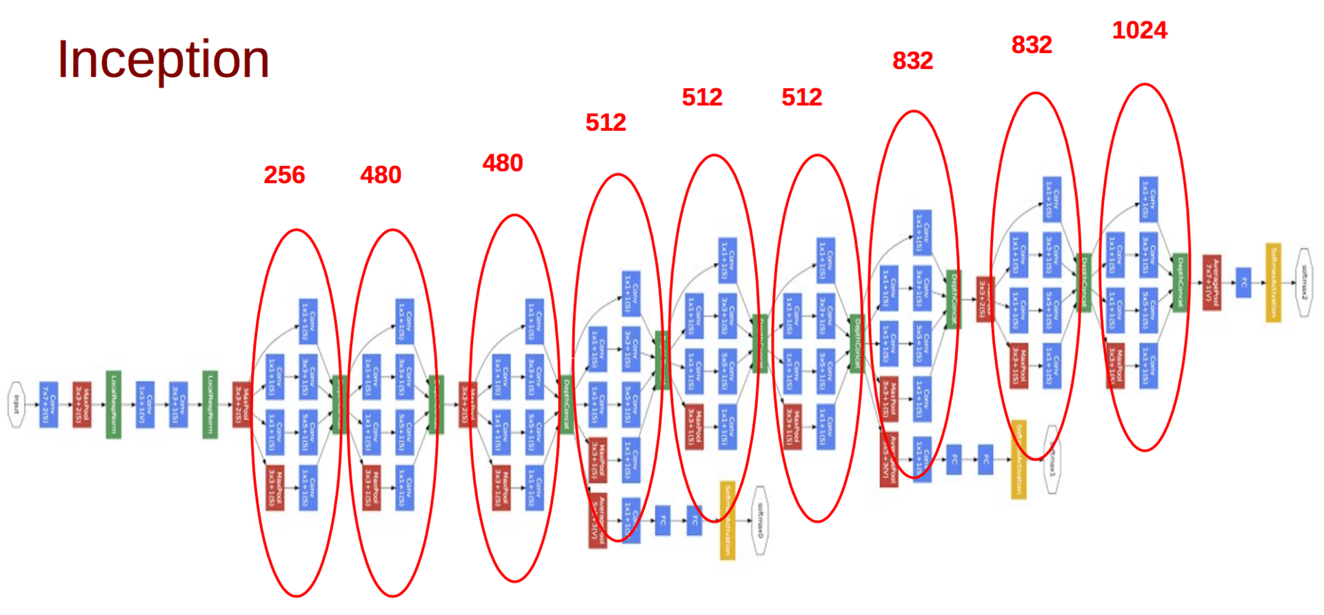
Inception от Google (17 Sep 2014)

Slide 31
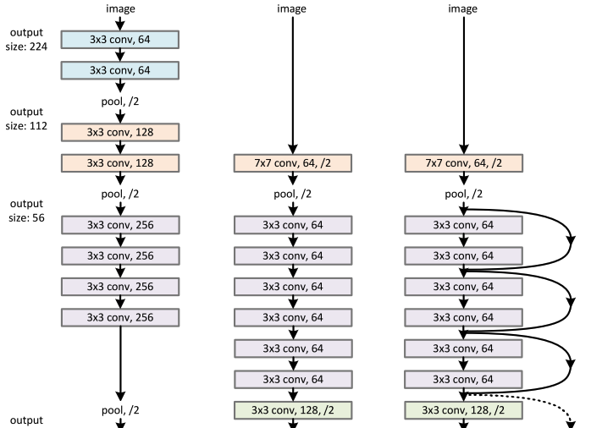
ResNET (10 Dec 2015)

Slide 32
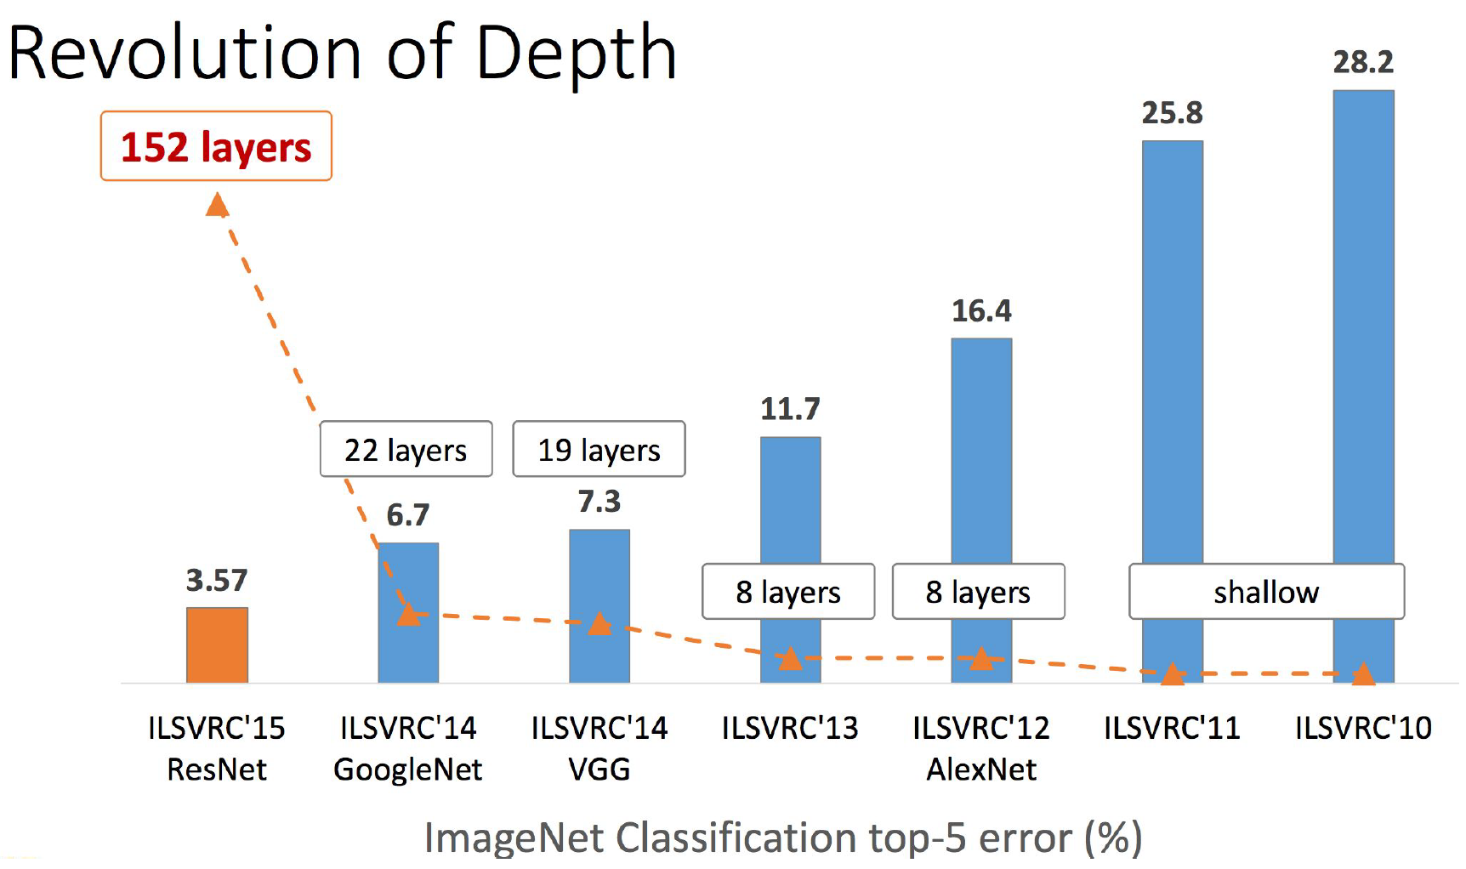
ResNET (10 Dec 2015)
Модель, с которой авторы победили на ImageNet, содержит меньше параметров, чем 19-слойный VGG, при глубине 152 слоя:

